Slide 1
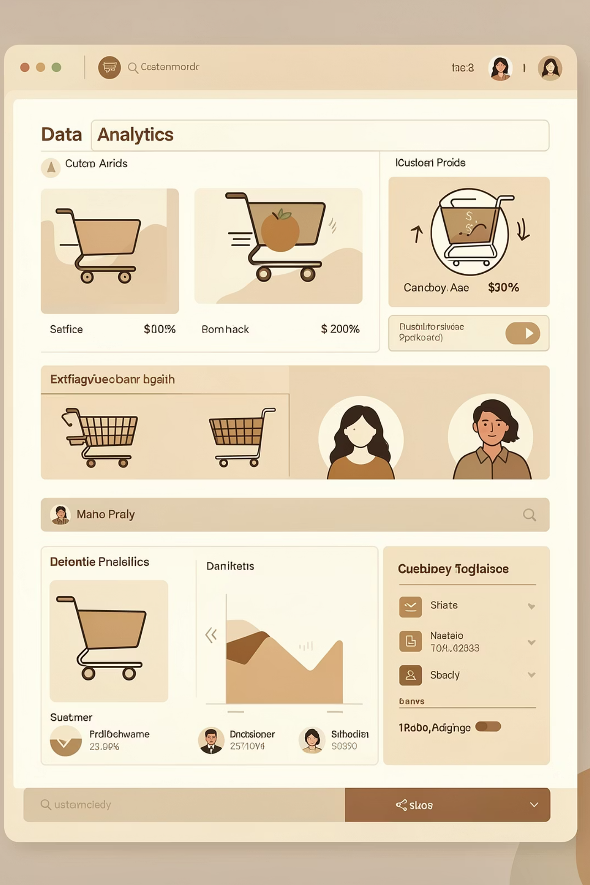
Customer Shopping Behavior Analysis
Uncovering insights from 3,900 purchases to drive strategic business decisions

Slide 2
DATASET OVERVIEW
The Foundation
3.9K
18
4
Total Purchases
Data Features
Product Categories
Key Data Points
Customer demographics & purchase history
Product details & seasonal trends
Shopping behavior & review ratings
Subscription & shipping preferences

Slide 3
PYTHON ANALYSIS
Data Preparation Journey
01
02
Data Loading & Exploration
Cleaning & Standardization
Imported dataset, checked structure and summary statistics
Handled missing values, renamed columns to snake case
03
04
Feature Engineering
Database Integration
Created age groups and purchase frequency metrics
Connected to PostgreSQL for advanced SQL analysis

Slide 4

SQL INSIGHTS
Key Business Questions
Structured analysis in PostgreSQL revealed critical patterns

Slide 5
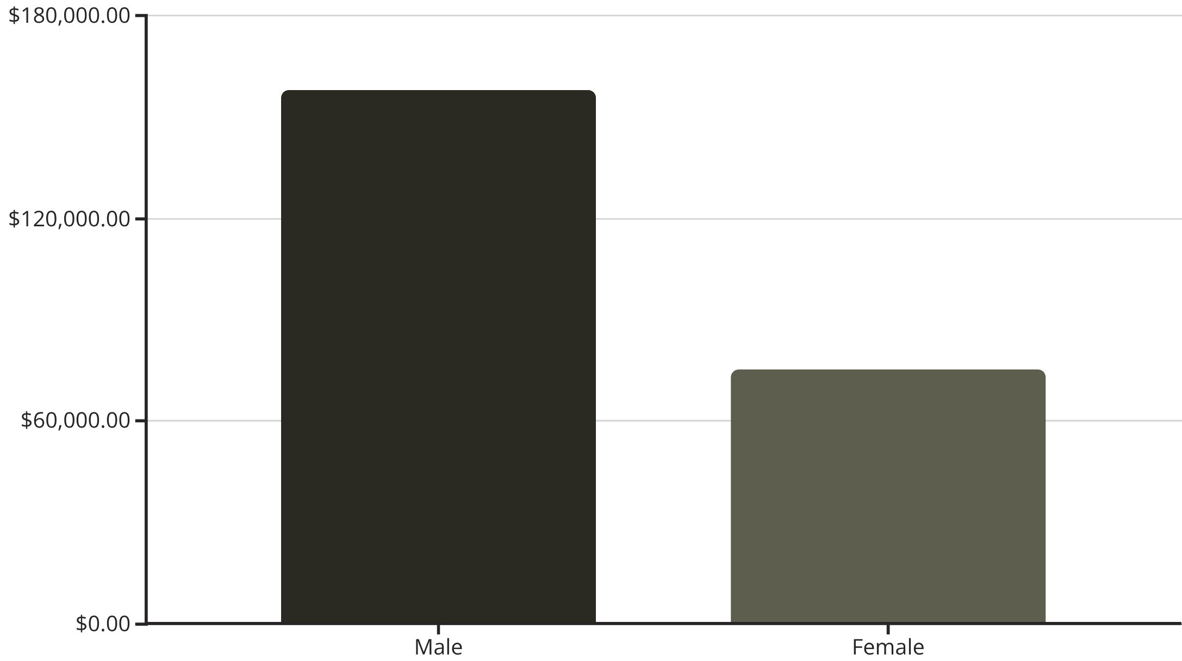

Revenue & Customer Patterns
Gender Revenue Gap
Male customers generate 2x more revenue than female customers, indicating potential for targeted marketing strategies.
839 customers used discounts but still spent above average

Slide 6
Product Performance Leaders
Top-Rated Products
97%
96%
95%
Gloves
Sandals
Boots
3.86 rating
3.84 rating
3.82 rating

Slide 7



Customer Segmentation Insights
Loyal Customers
Returning Buyers
New Customers
3,116 customers (80%)
701 customers (18%)
83 customers (2%)
Backbone of revenue
Growth opportunity
Acquisition focus

Slide 8
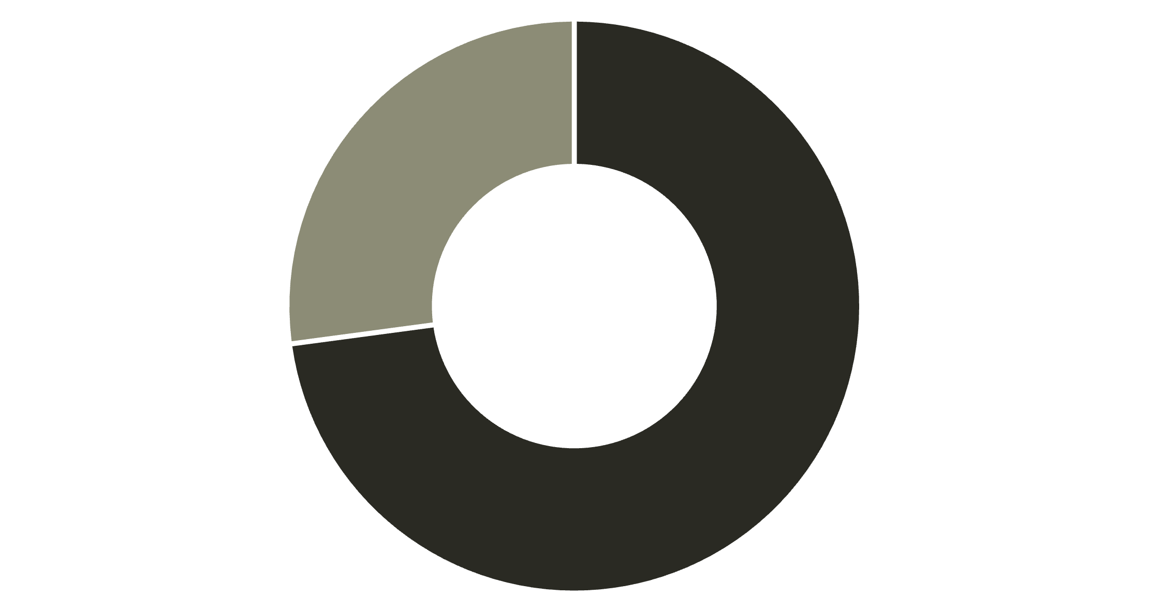
Subscription & Shipping Analysis
Subscription Opportunity
Only 27% are subscribers despite similar spending patterns
Express shipping users spend $2 more on average
Non-Subscribers
Subscribers
Subscribers
Non-Subscribers
$59.49 avg spend
$59.87 avg spend

Slide 9
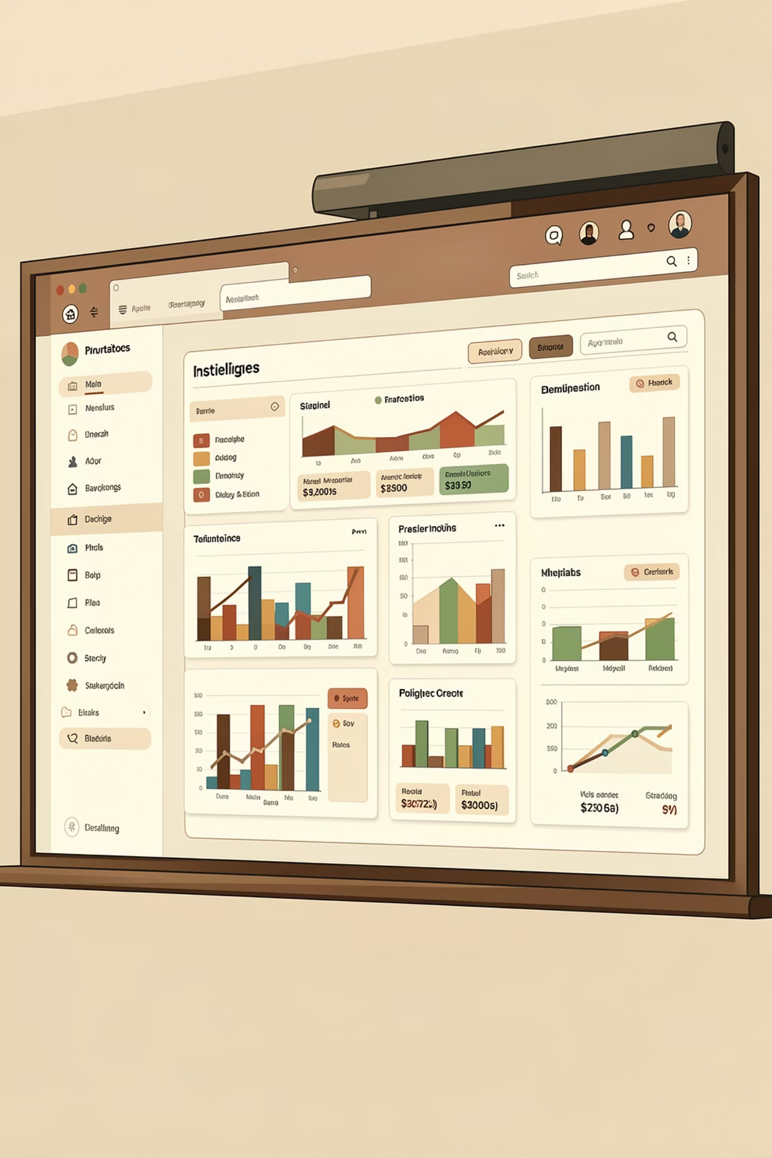

POWER BI
Interactive Dashboard
Real-time insights across customer behavior, revenue patterns, and product performance

Slide 10




ACTION PLAN
Strategic Recommendations
Boost Subscriptions
Loyalty Programs
Promote exclusive benefits to convert 73% non-subscribers
Reward repeat buyers to strengthen loyal segment
Targeted Marketing
Review Discounts
Focus on high-revenue age groups and express shipping users
Balance sales boosts with margin control strategies

